Slide 1
Requirements Engineering Process
CSE-478 (Fall 2011)

Slide 2
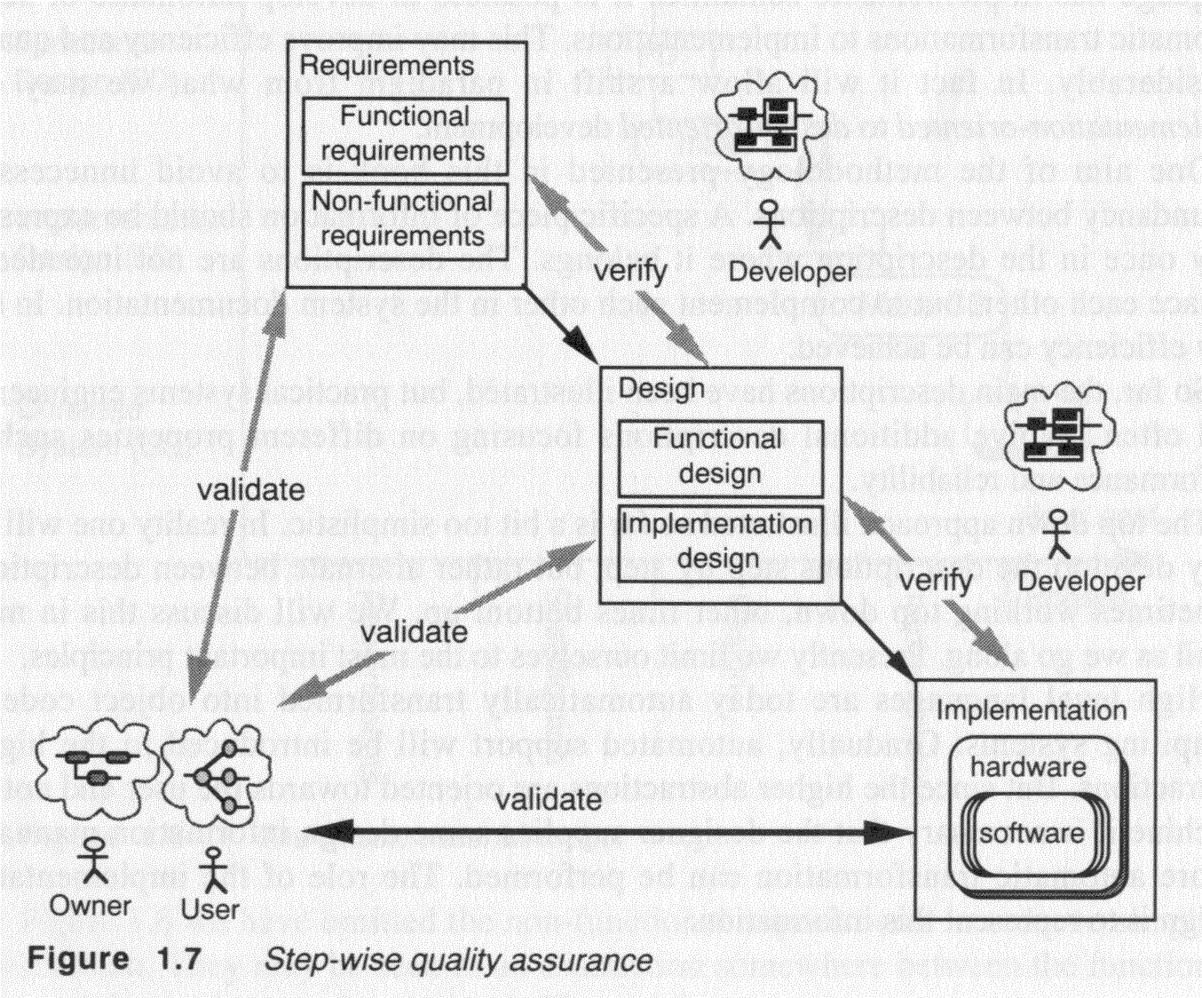
Requirements within the software development process

Slide 3
Key Points
The Requirements Engineering Process
Problem Domain and the System/Software-to-be
Requirements Engineering: Main Activities

Slide 4
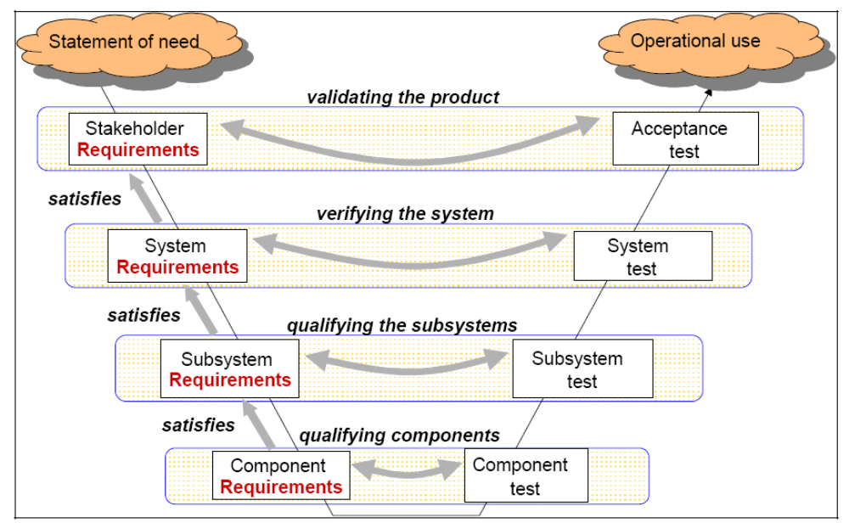
Typical Layered Approach (V-shaped)
Failures Requirements Definition/Importance Requirements Types Development Process Requirements Activities
Source: Hull, Jackson, Dick: Requirements Engineering, 2004

Slide 5
Typical Layered Approach – Contd…
The layers correspond to step-wise refinement in terms of component decomposition.
The transition from the first to the second layer is the typical RE process: starting with the information from elicitation and ending up with a proposal for a new system to be built.
The process of identification of the system to be built and defining its relationship with the new domain model is a “design process”.
The transitions to the lower layers in the diagram are similar processes (may call them RE at a more detailed level or design processes)

Slide 6
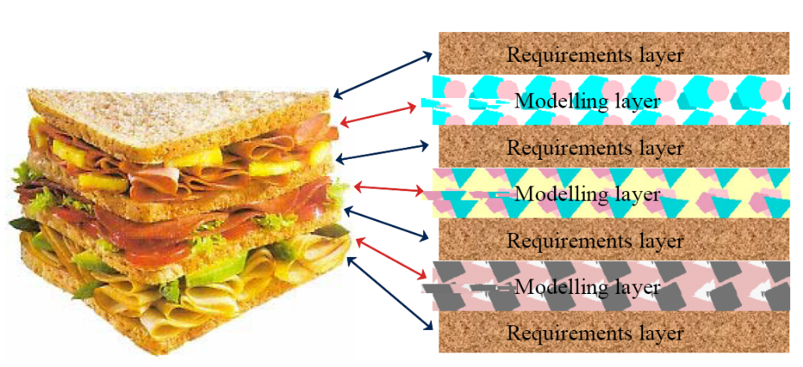
Requirements and Modeling go together
Failures Requirements Definition/Importance Requirements Types Development Process Requirements Activities
The systems engineering sandwich!
Source: http://www.telelogic.com/download/paper/SystemsEngineeringSandwich.pdf

Slide 7
Why combining RE with modeling ?
For analysis – models help to understand the problem domain
For documentation – models can be used for describing requirements (instead of solely using natural language)

Slide 8
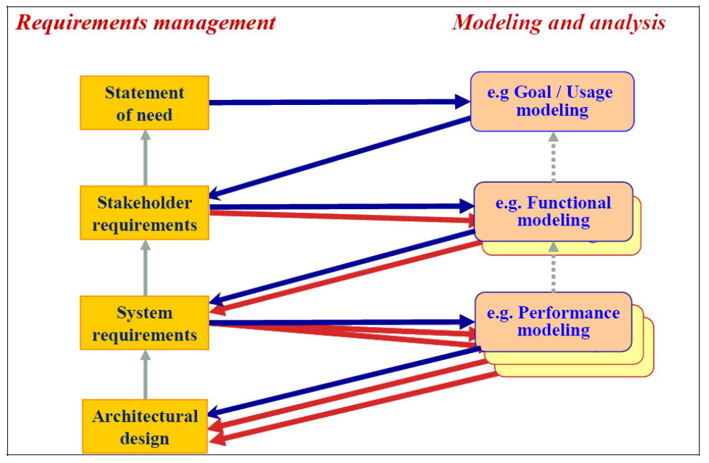
Back to the Sandwich – consider different levels of details
Failures Requirements Definition/Importance Requirements Types Development Process Requirements Activities
Source: Hull, Jackson, Dick: Requirements Engineering, 2004

Slide 9
RE Process and Related Activities
Failures Requirements Definition/Importance Requirements Types Development Process Requirements Activities
Why?
What?
How?
Who?
When?
If-Then
Does It?
Where?
Identify Business Needs and Goals
Derive User & Functional Requirements
Time
Design Solutions
TIME
Project Management Process
Risk Management Process
Quality Management Process
Component & Configuration Management Process

Slide 10
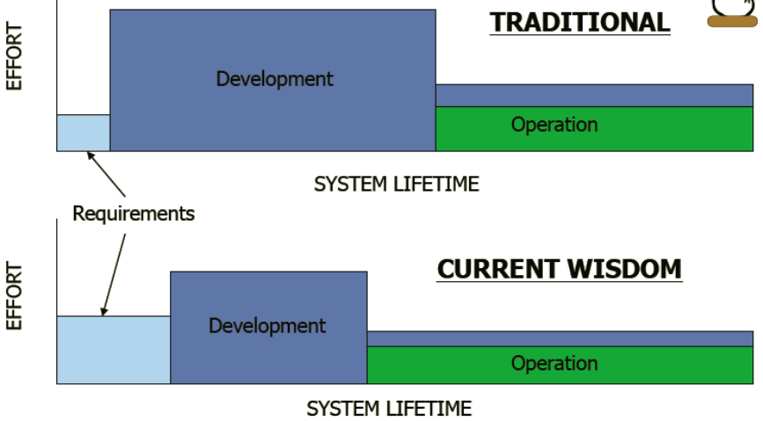
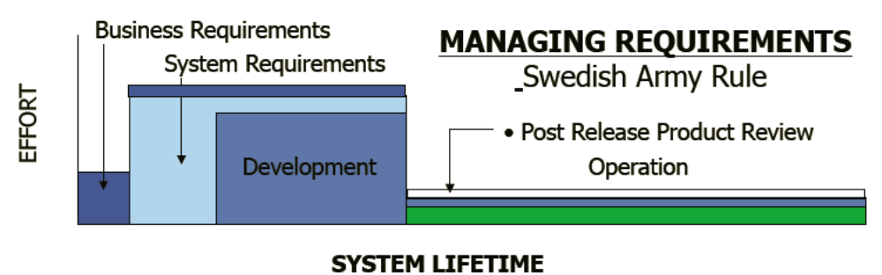
Requirements Engineering
Failures Requirements Definition/Importance Requirements Types Development Process Requirements Activities
Requirements engineering is a set of activities but not necessarily a separate phase
Source: Donald C. Gause, Risk Focused Requirements Management, Tutorial at RE’09, September 2009

Slide 11
The Problem Domain and the System/Software-to-be

Slide 12
Problem Domain
Failures Requirements Definition/Importance Requirements Types Development Process Requirements Activities
The problem domain is the context for requirements
  Part of the world within which the problem exists
  Needs to be understood for effective requirements engineering
Domain model
  Set of properties assumed / believed to be true about the environment
  Properties relevant to the problem
  Problem domain requirements should hold in the proposed new version of the domain.
Define the system requirements such that:
  If the system that is built satisfies the system requirements and the environment satisfies the properties assumed for the environment, then the problem domain requirements will be satisfied.
  In simple words: The system will behave as required if the assumptions hold.

Slide 13
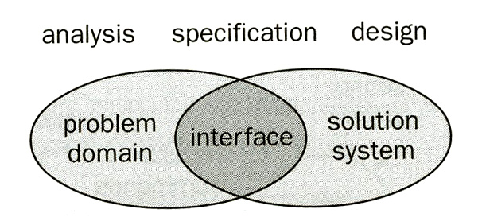
Problem Domain and System-to-be
Failures Requirements Definition/Importance Requirements Types Development Process Requirements Activities
Diagram showing activities [Bray]

Slide 14
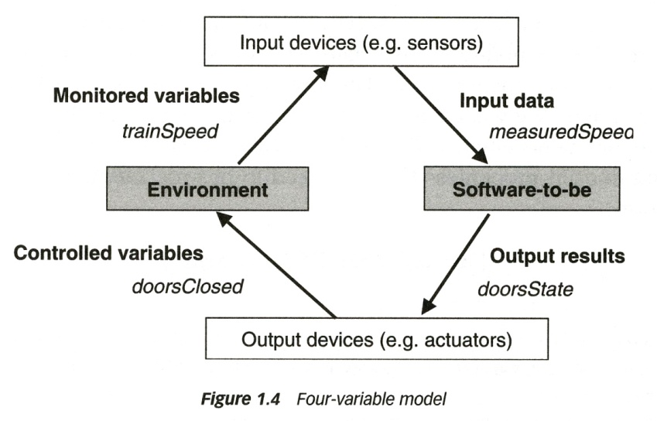
System interface and software interface
Generic architecture of a control system including embedded software [Lamsweerde]
System and software interface for a control system with embedded software:
  Software interface: through input and output variables, for instance measuredSpeed (is read by program) and doorState (is set by program)
  The system includes the software and I/O devices. Therefore the interface of the system with the environment are the monitored and controlled variables of the real world, for instance trainSpeed and doorsClosed.

Slide 15
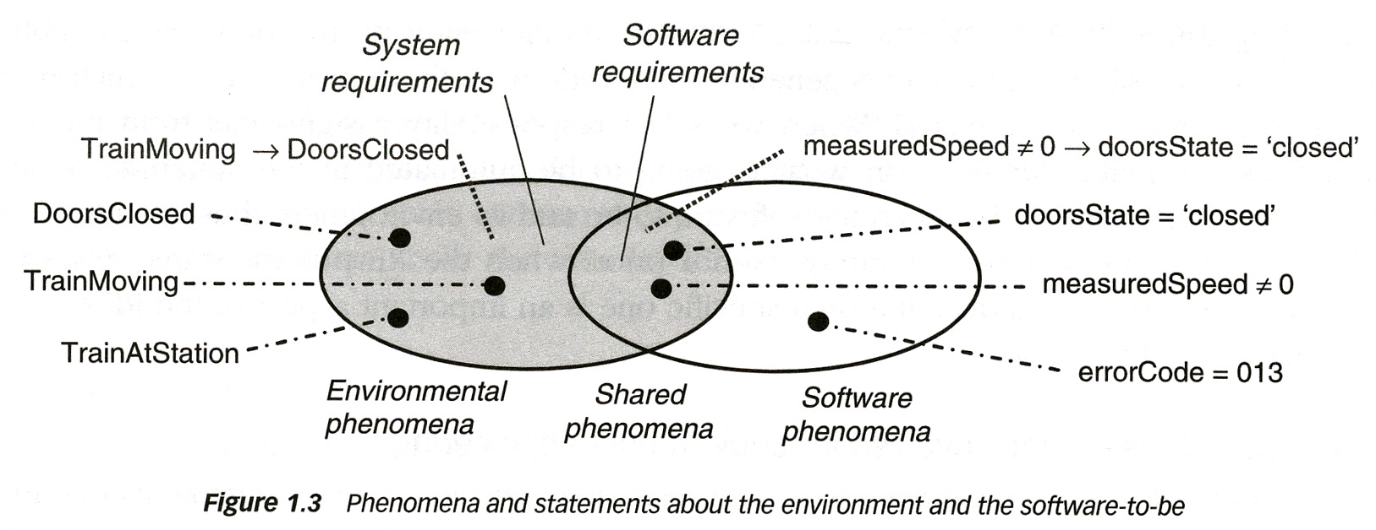
Software objects representing real objects
The software (model) normally contains objects that represent objects in the system environment (e.g. the doorState variable represents the state of the doors in the train)
Whether they represent the situation in the environment correctly, is another question (for the doorState variable, this may depend on the correct functioning of the door state sensing device).
Problem domain requirements (if one considers the train to be the environment of the control system)
[Lamsweerde]

Slide 16
Main Requirements Activities

Slide 17
Requirements Inception
Failures Requirements Definition/Importance Requirements Types Development Process Requirements Activities
Start the process
  Identification of business need
  New market opportunity
  Great idea
Involves
  Building a business case
  Preliminary feasibility assessment
  Preliminary definition of project scope
Stakeholders
  Business managers, marketing people, product managers...
Examples of techniques
  Brainstorming, Joint Application Development (JAD) meeting…

Slide 18
Requirements Elicitation (1)
Failures Requirements Definition/Importance Requirements Types Development Process Requirements Activities
Gathering of information
  About problem domain
  About problems requiring a solution
  About constraints related to the problem or solution
Questions that need to be answered
  What is the system?
  What are the goals of the system?
  How is the work done now?
  What are the problems?
  How will the system solve these problems?
  How will the system be used on a day-to-day basis?
  Will performance issues or other constraints affect the way the solution is approached?

Slide 19
Requirements Elicitation (2)
Failures Requirements Definition/Importance Requirements Types Development Process Requirements Activities
Overview of different sources
  Customers and other stakeholders
  Existing systems
  Documentation
  Domain experts
  More ...
Overview of different techniques
  Brainstorming
  Interviews
  Task observations
  Use cases / scenarios
  Prototyping
  More ...

Slide 20
Requirements Analysis
Failures Requirements Definition/Importance Requirements Types Development Process Requirements Activities
The process of studying and analyzing the needs of stakeholders (e.g., customer, user) in view of coming up with a “solution”. Such a solution may involve:
  A new organization of the workflow in the company.
  A new system (system-to-be, also called solution domain) which will be used in the existing or modified workflow.
  A new software to be developed which is to run within the existing computer system or involving modified and/or additional hardware.
Objectives
  Detect and resolve conflicts between requirements (e.g., through negotiation)
  Discover the boundaries of the system / software and how it must interact with its environment
  Elaborate system requirements to derive software requirements

Slide 21
Requirements Specification
Failures Requirements Definition/Importance Requirements Types Development Process Requirements Activities
The invention and definition of the behavior of a new system (solution domain) such that it will produce the required effects in the problem domain
Requirements Analysis has defined the problem domain and the required effects
Specification Document
  A document that clearly and precisely describes, each of the essential requirements (functions, performance, design constraints, and quality attributes) of the software and the external interfaces
  Each requirement being defined in such a way that its achievement is capable of being objectively verified by a prescribed method (e.g., inspection, demonstration, analysis, or test)
  Different guidelines and templates exist for requirements specification

Slide 22
Requirements Verification and Validation
Failures Requirements Definition/Importance Requirements Types Development Process Requirements Activities
Validation and verification
  Both help ensure delivery of what the client wants
  Need to be performed at every stage during the process
Validation: checks that the right product is being built (refers back to stakeholders – main concern during RE)
Verification: checks that the product is being built right
  During design phase: refers back to the specification of the system or software requirements
  During RE: mainly checking consistency between different requirements, detecting conflicts
Techniques used during RE
  Simple checks
  Formal Review
  Logical analysis
  Prototypes
  Design of functional tests
  Development of user manual

Slide 23
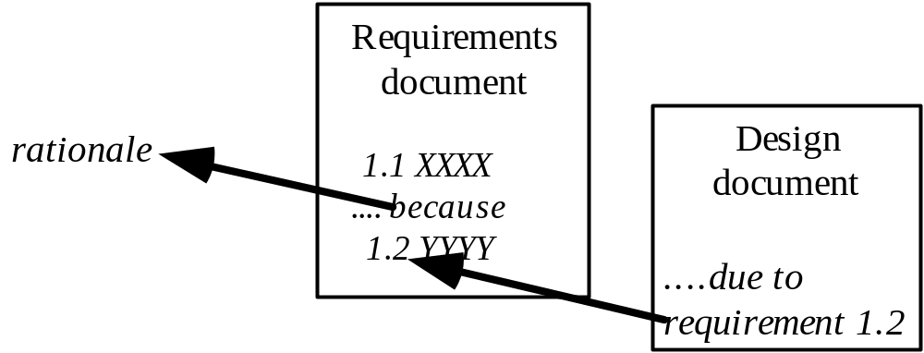
Requirements Management
Failures Requirements Definition/Importance Requirements Types Development Process Requirements Activities
Necessary to cope with changes to requirements
Requirements change is caused by:
  Business process changes
  Technology changes
  Better understanding of the problem
Traceability is very important for effective requirements management
Elicitation notes
Goals

Slide 24
Requirements Documents
Failures Requirements Definition/Importance Requirements Types Development Process Requirements Activities
Vision and Scope Document
Elicitation notes: (Raw) requirements obtained through elicitation; often unstructured, incomplete, and inconsistent
(Problem domain) Requirements document
System requirements document
Software requirements document
  The software is normally part of a system that includes hardware and software. Therefore the software requirements are normally part of the system requirements.
Note: System and Software requirements may exist in several versions with different levels of details, such as
  User (customer) requirements: Statements in natural language plus diagrams of the services the system provides and its operational constraints; written for customers
  Detailed requirements: A structured document setting out detailed descriptions of the system services; often used as a contract between client and contractor. This description can serve as a basis for a design or implementation; used by developers.

Slide 25
Types of Requirements Documents
Failures Requirements Definition/Importance Requirements Types Development Process Requirements Activities
Two extremes:
An informal outline of the requirements using a few paragraphs or simple diagrams
  This is called the requirements definition
A long list of specifications that contain
tens / hundreds of pages of intricate
requirements describing the
system in detail
  This is called the requirements
  specification
Requirements documents for
large systems are normally
arranged in a hierarchy
Requirements
xxxx
xxxxxxx
xxx
xxxxxxxxxxx
xxxxx
xxxxxxxxxxxxx
xxxxxxx
xxx
xxxxxxxxxxxxxxx
subsystem 1
subsystem 2
Requirements
Requirements
xxxx
Definition
xxxxxxx
xxxx
xxx
xxxxxxx
Requirements
xxxxxxxxxxx
xxx
xxxxx
xxxxxxxxxxx
Specification
xxxxxxxxxxxxx
xxxxx
xxxxxxx
xxxx
xxx
xxxxxxxxxxxxx
xxxxxxxxxxxxxxx
xxxxxxx
xxxxxxx
xxx
xxx
xxxxxxxxxxx
xxxxxxxxxxxxxxx
xxxxx
xxxxxxxxxxxxx
sub-subsystems
xxxxxxx
xxx
Requirements
Requirements
Requirements
xxxxxxxxxxxxxxx
Requirements
Definition
Definition
Definition
Definition
xxxx
xxxx
xxxx
sub-subsystems
xxxx
xxxxxxx
xxxxxxx
xxxxxxx
Requirements
xxxxxxx
xxx
Requirements
xxx
Requirements
xxx
xxx
Requirements
xxxxxxxxxxx
xxxxxxxxxxx
xxxxxxxxxxx
Specification
xxxxxxxxxxx
Specification
xxxxx
Specification
xxxxx
Specification
xxxxx
xxxx
xxxxx
xxxxxxxxxxxxx
xxxxxxxxxxxxx
Requirements
xxxx
xxxx
xxxxxxx
Requirements
xxxxxxxxxxxxx
xxxxxxxxxxxxx
xxxxxxx
Requirements
xxxxxxx
xxxx
xxxxxxx
xxxxxxx
xxxxxxx
xxxxxxx
xxx
xxx
Requirements
Definition
Definition
xxxxxxx
xxx
xxx
xxx
xxx
xxxxxxxxxxx
Definition
xxx
xxx
xxxxxxxxxxxxxxx
xxxxxxxxxxxxxxx
Definition
xxxx
xxxxxxxxxxx
xxxxxxxxxxx
xxxxx
xxxx
xxxxxxx
xxxxxxxxxxxxxxx
xxxxxxxxxxxxxxx
xxxx
xxxxxxxxxxx
xxxxx
xxxxx
xxxxxxxxxxxxx
xxxx
xxxxxxx
xxxxxxx
xxx
Requirements
xxxxx
xxxxxxxxxxxxx
xxxxxxxxxxxxx
xxxxxxx
xxxxxxx
xxx
Requirements
xxx
Requirements
xxxxxxxxxxx
xxxxxxxxxxxxx
xxxxxxx
xxxxxxx
xxx
xxx
Requirements
xxxxxxxxxxx
xxxxxxxxxxx
Specification
xxxxx
Specification
xxxxxxx
xxx
xxx
xxxxxxxxxxxxxxx
xxxxxxxxxxx
xxxxx
Specification
xxxxx
xxxx
xxx
xxxxxxxxxxxxxxx
xxxxx
Specification
xxxxxxxxxxxxx
xxxxxxxxxxxxx
xxxxxxxxxxxxxxx
xxxx
xxxx
xxxxxxx
xxxxxxx
xxxxxxxxxxxxxxx
xxxxxxxxxxxxx
xxxxxxxxxxxxx
xxxxxxx
xxxx
xxxxxxx
xxxxxxx
xxxxxxx
xxxxxxx
xxx
xxx
xxxxxxx
xxx
xxx
xxx
xxx
xxxxxxxxxxx
xxx
xxx
xxxxxxxxxxxxxxx
xxxxxxxxxxxxxxx
xxxxxxxxxxx
xxxxxxxxxxx
xxxxx
xxxxxxxxxxxxxxx
xxxxxxxxxxxxxxx
xxxxxxxxxxx
xxxxx
xxxxx
xxxxxxxxxxxxx
xxxxx
xxxxxxxxxxxxx
xxxxxxxxxxxxx
xxxxxxx
xxxxxxxxxxxxx
xxxxxxx
xxxxxxx
xxx
xxxxxxx
xxx
xxx
xxxxxxxxxxxxxxx
xxx
xxxxxxxxxxxxxxx
xxxxxxxxxxxxxxx
xxxxxxxxxxxxxxx

Slide 26

The Requirements Analyst¹
Failures Requirements Definition/Importance Requirements Types Development Process Requirements Activities
Plays an essential communication role
  Talks to users: application domain
  Talks to developers: technical domain
  Translates user requirements into functional requirements and quality goals
Needs many capabilities
  Interviewing and listening skills
  Facilitation and interpersonal skills
  Writing and modeling skills
  Organizational ability
RE is more than just modeling…
This is a social activity!
[1] Karl Wiegers, In Search of Excellent Requirements

Slide 27
Main References
Jeremy Dick, Elizabeth Hull, Ken Jackson: Requirements Engineering, Springer-Verlag, 2004
Soren Lauesen: Software Requirements - Styles and Techniques, Addison Wesley, 2002
Ian K. Bray: An Introduction to Requirements Engineering, Addison Wesley,
2002
Karl E. Wiegers: Software Requirements, Microsoft Press,
2003
Gerald Kotonya, Ian Sommerville: Requirements Engineering – Processes and Techniques, Wiley, 1998
Roger S. Pressman: Software Engineering – A Practitioner's Approach, McGraw-Hill, 2005
Tim Lethbridge, Robert Laganière: Object Oriented Software Engineering: Practical Software Developement using UML and Java, 2nd edition, McGraw-Hill, 2005
Ivy F. Hooks, Kristin A. Farry: Customer-Centered Products – Creating Successful Products Through Smart Requirements Management, Amacom, 2001
CHAOS Report, Standish Group










